Slide 1
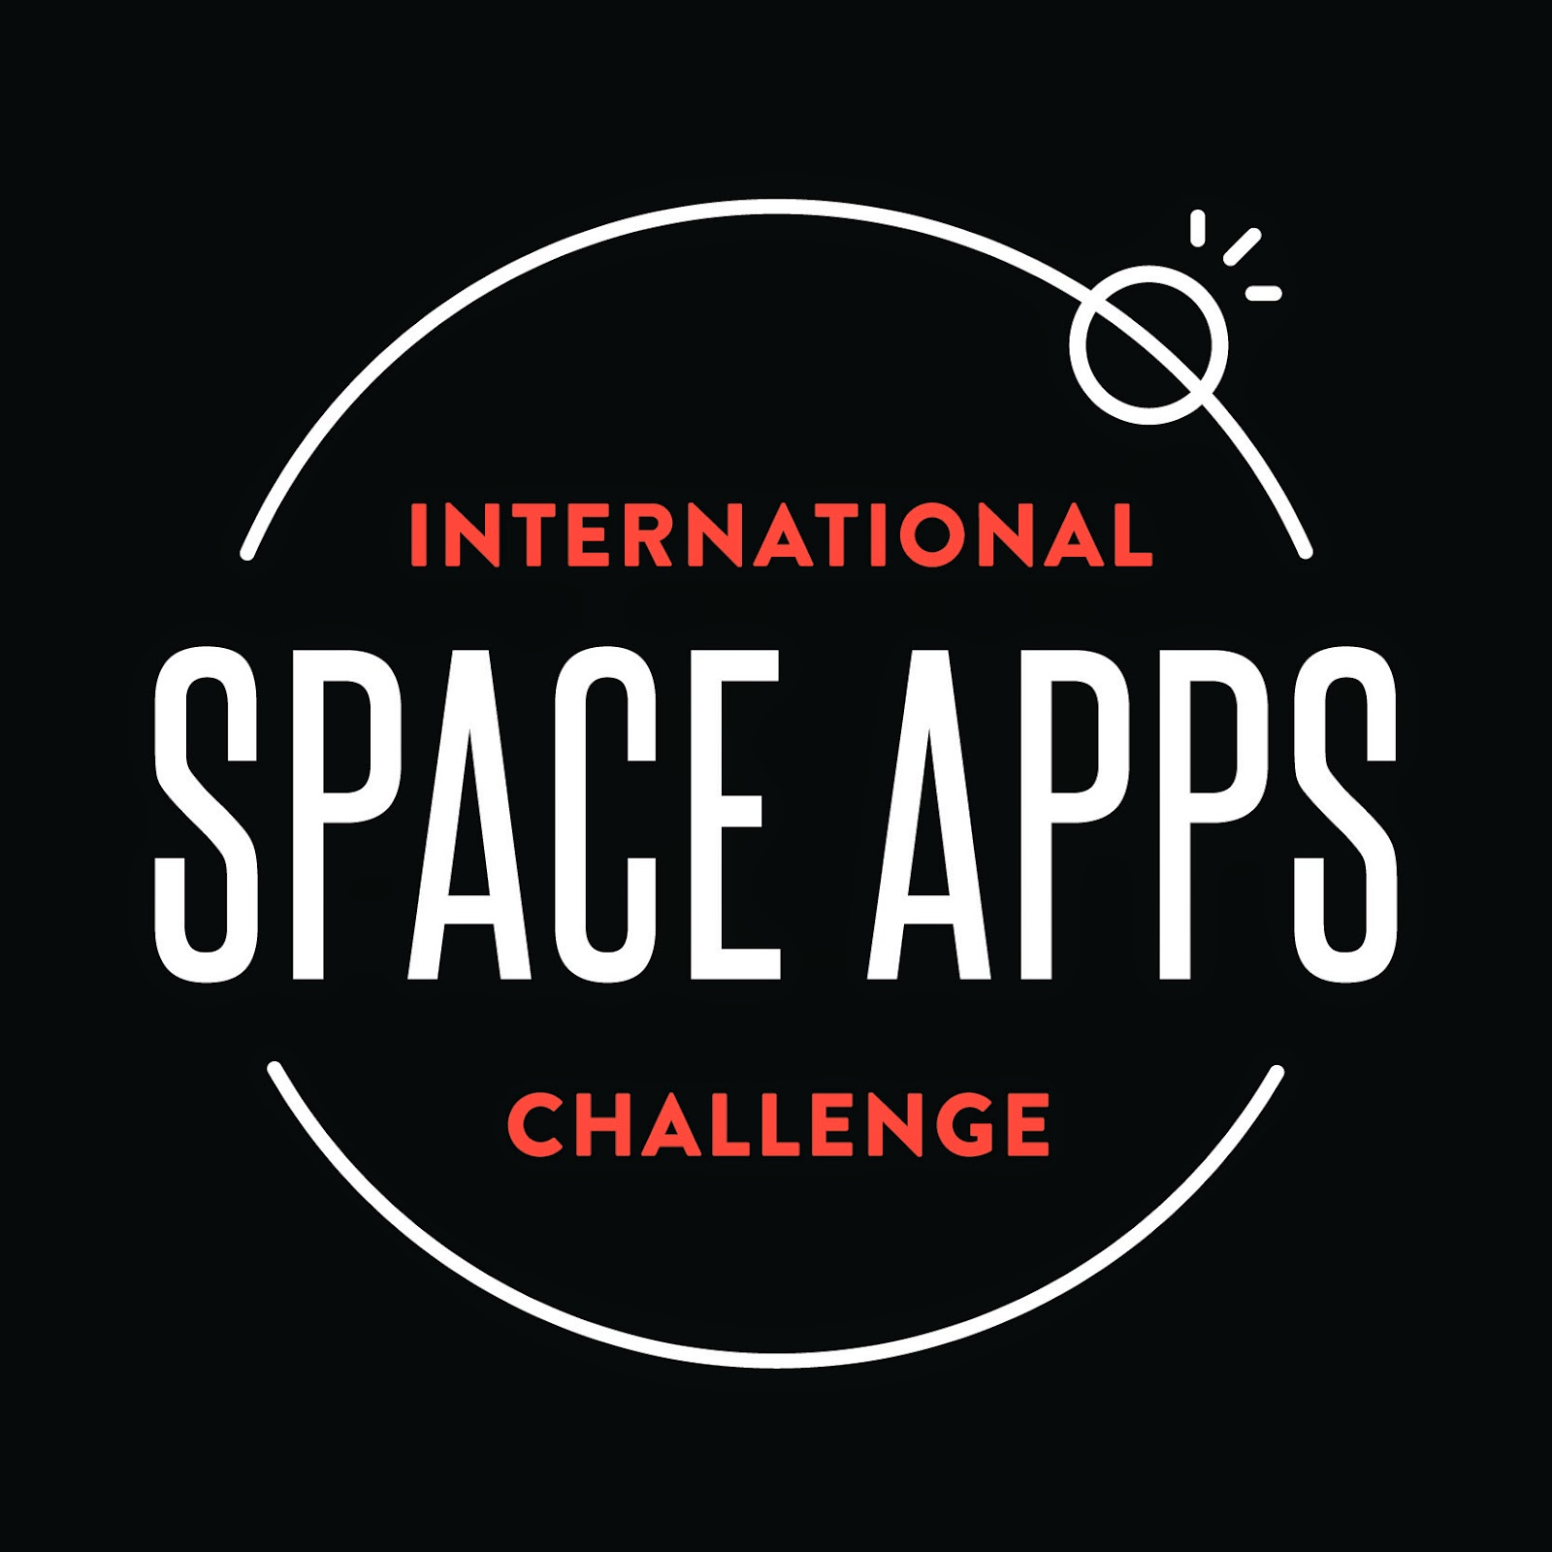

Slide 2
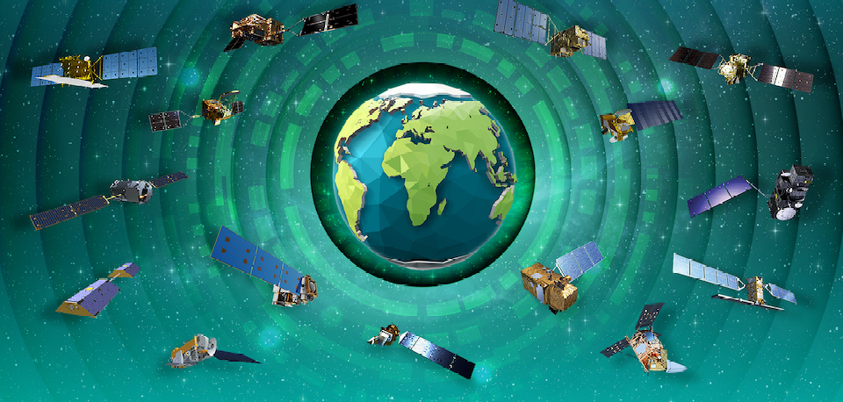
NIMBUS TO NOW:
THE HISTORY OF NASA’S EARTH-OBSERVING MISSIONS

Slide 3
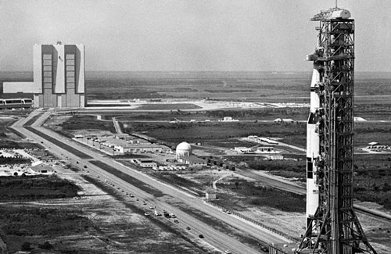
About NASA
NASA was created largely in response to the Soviet launching of Sputnik in 1957. It was organized around the National Advisory Committee for Aeronautics (NACA), which had been created by Congress in 1915. NASA's organization was well under way by the early years of Pres.

Slide 4
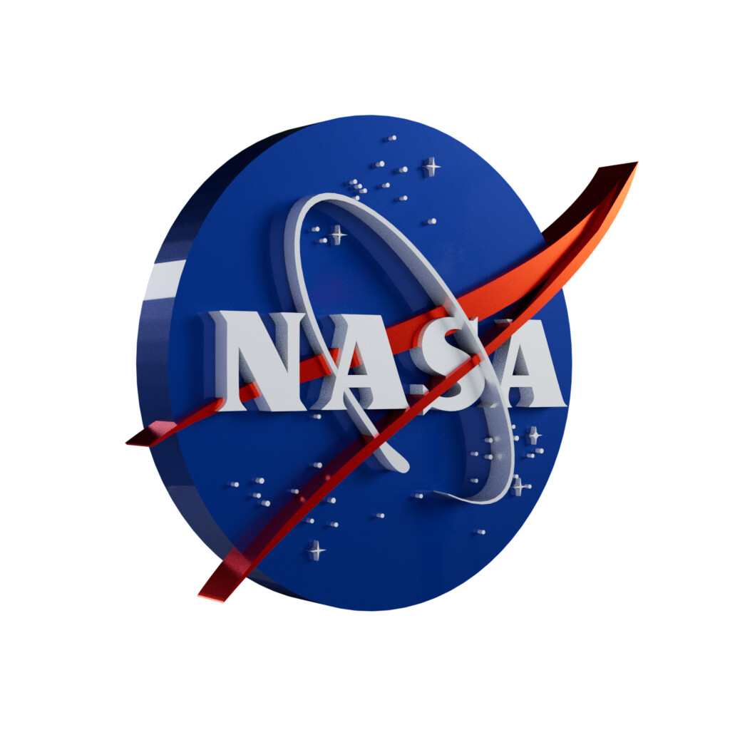
NASA stands for National Aeronautics and Space Administration.
NASA is a U.S. government agency that is responsible for science and technology related to air and space. The Space Age started in 1957 with the launch of the Soviet satellite Sputnik. NASA opened for business on Oct. 1, 1958.

Slide 5
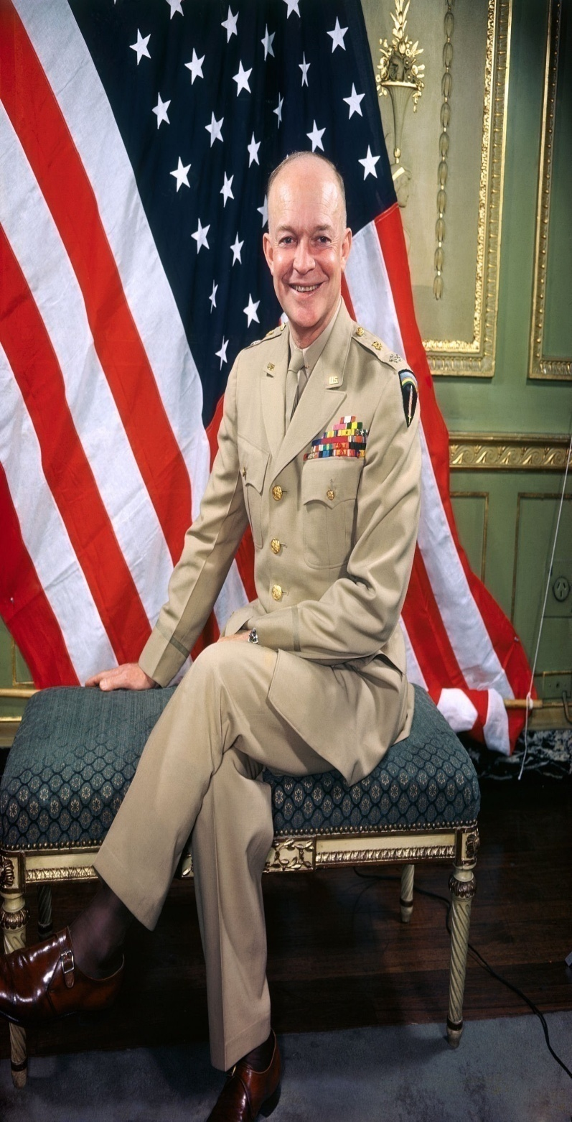
Founder of NASA Dwight D.Eisenhower Hall of fame induction: 2009 Organizations founded: NASA, DARPA, MORE
President Dwight Eisenhower (center) presents commissions to T. Keith Glennan (left) and Hugh L. Dryden (right), NASA's first administrator and deputy administrator respectively. In July 1958, Eisenhower had signed the National Aeronautics and Space Act, creating the agency, which opened for business on Oct.

Slide 6

Completed missions:
Active Cavity Radiometer Irradiance Monitor Satellite (ACRIMSAT)
-(Earth Observing System (EOS)
Applications Technology Satellite (ATS)
-(Historical Missions)

Slide 7
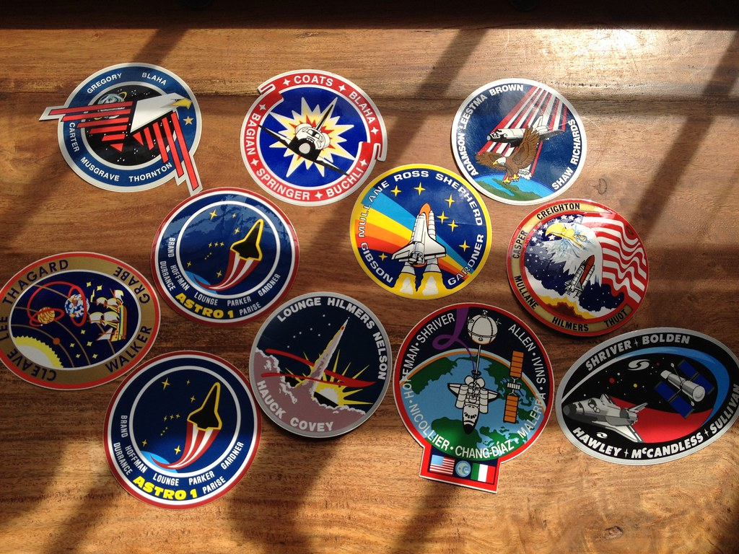
Some Of The Important Missions(of NASA)
Completed missions
Current missions
Future missions

Slide 8
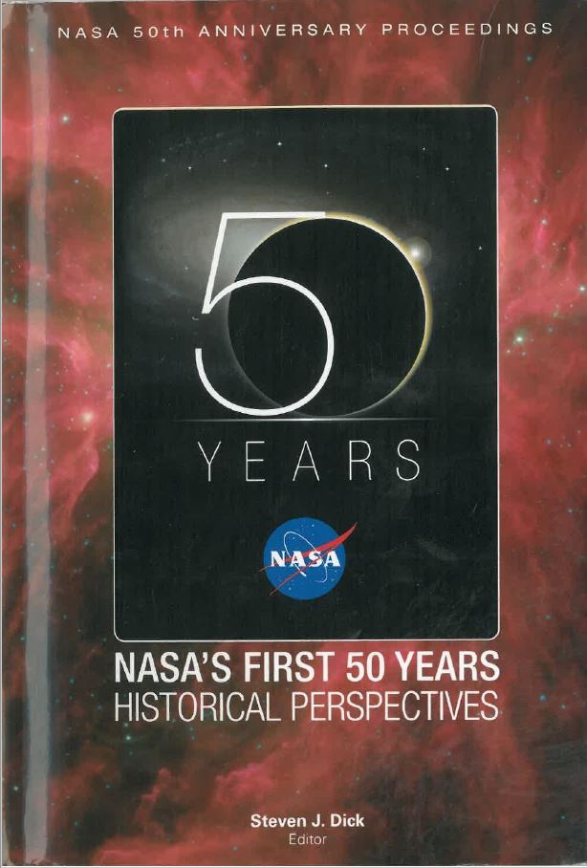
Current Missions
Aqua | Earth Observing System (EOS) A-Train
Aura | Earth Observing System (EOS) A-Train

Slide 9
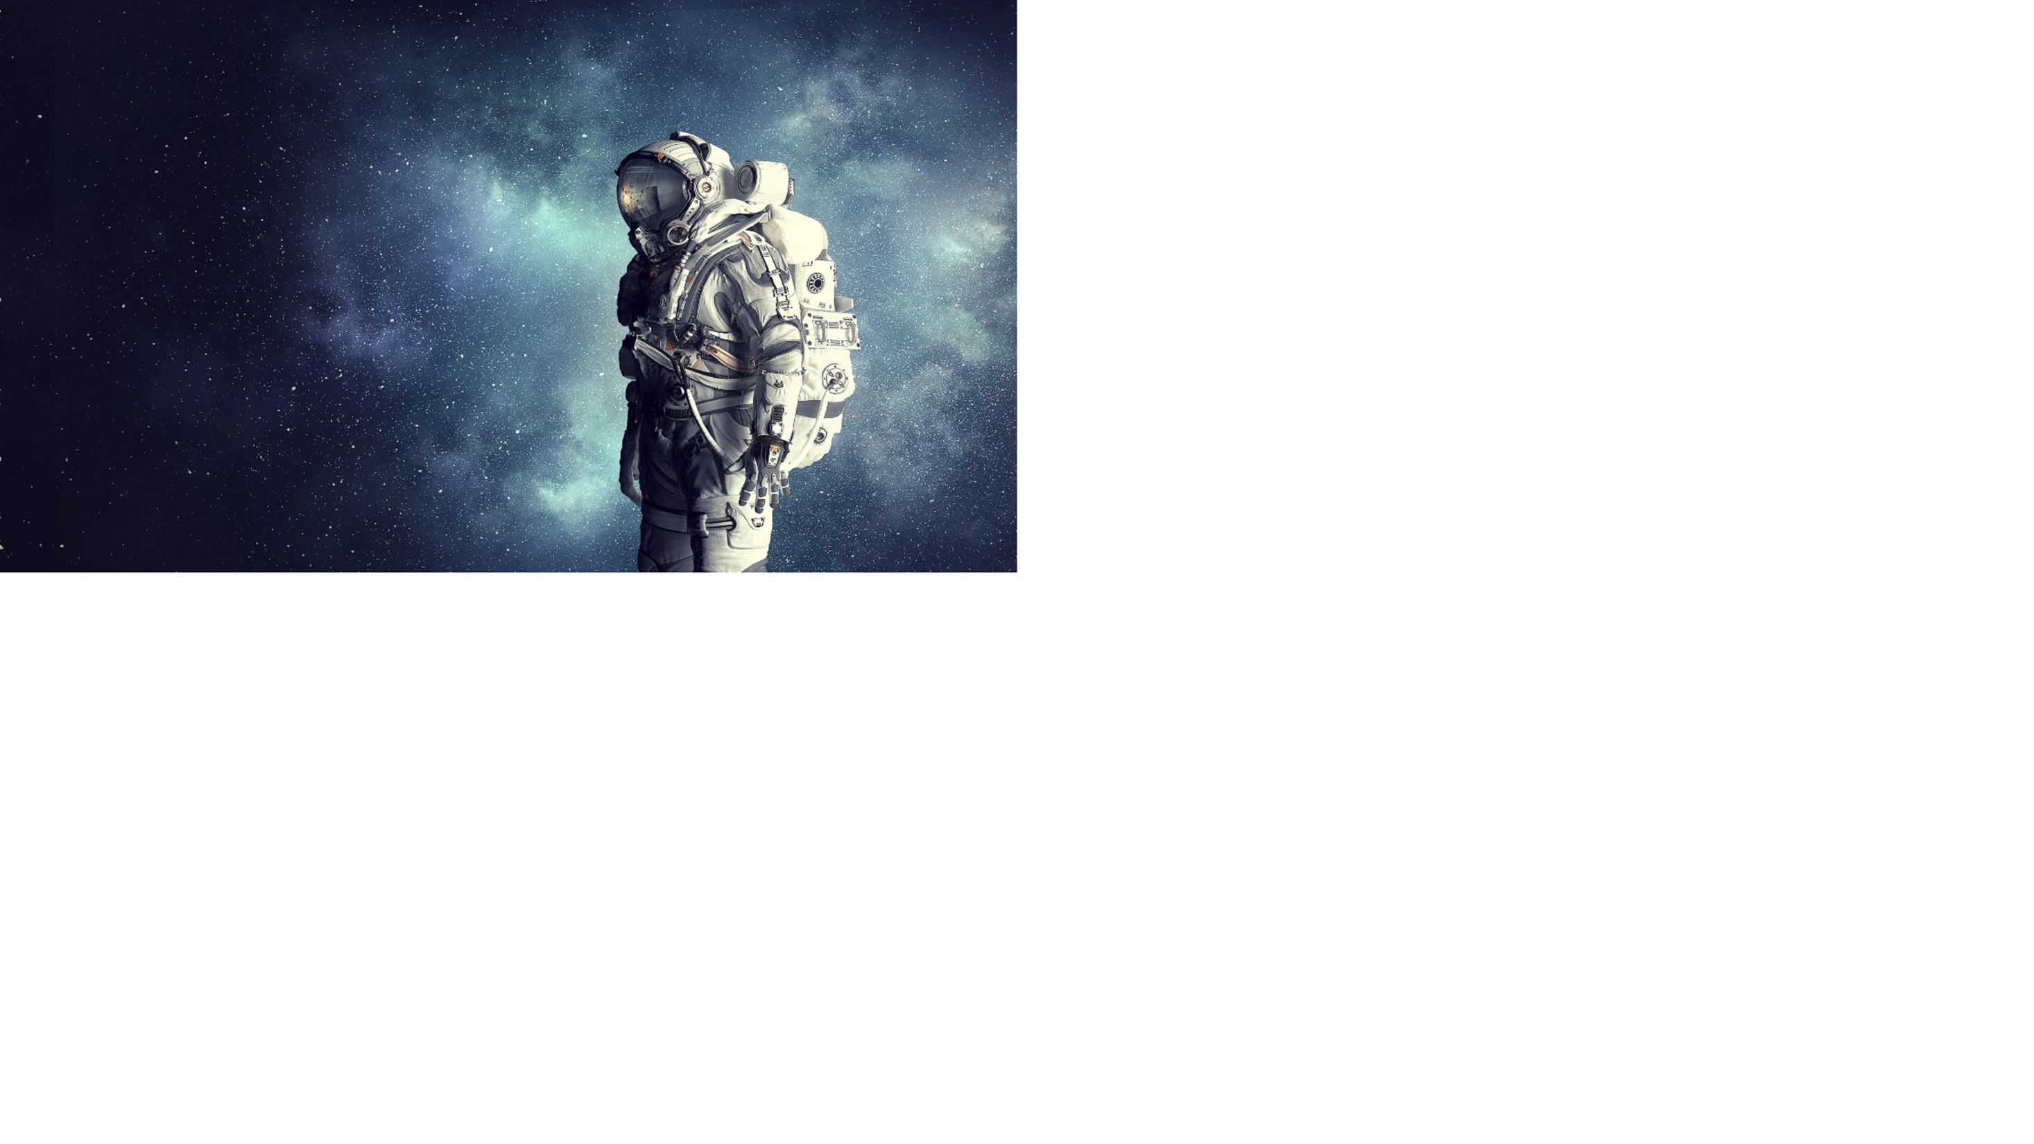
Future Missions
Sentinel-6B | Inter-Agency Partnerships
Climate Absolute Radiance and Refractivity Observatory Pathfinder (CLARREO Path.) | Earth Systematic Missions Program

Slide 10
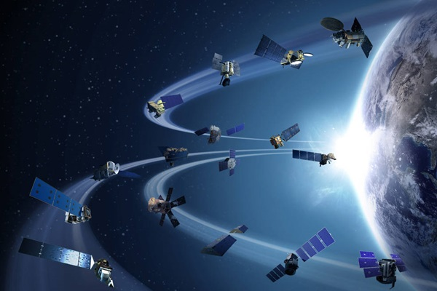
News
NASA, ESA, and JAXA will continue through June 2024 to advance their joint work to communicate tri-agency scientific findings with societal impact, further developing this Dashboard, enhancing the data and stories, collaborating with global experts and communities, and promoting Open Science. Click here to read the full Joint Declaration on trilateral collaboration by NASA, ESA and JAXA.

Slide 11
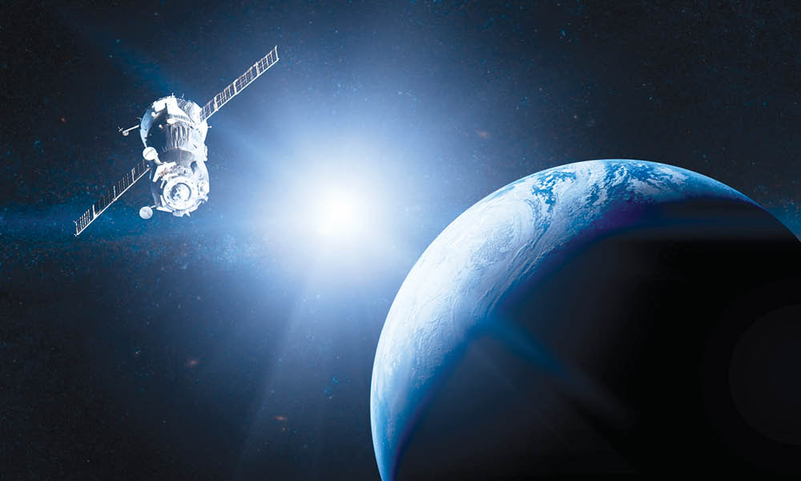
Earth observation satellites
By observing the Earth from space, satellites provide essential information on ocean, ice, land environments, and the atmosphere. Earth-observation satellites help us monitor and protect our environment, manage our resources, and ensure the safety and security of Canadians. Satellite imagery and expertise is also used to support global humanitarian efforts and sustainable development.

Slide 12
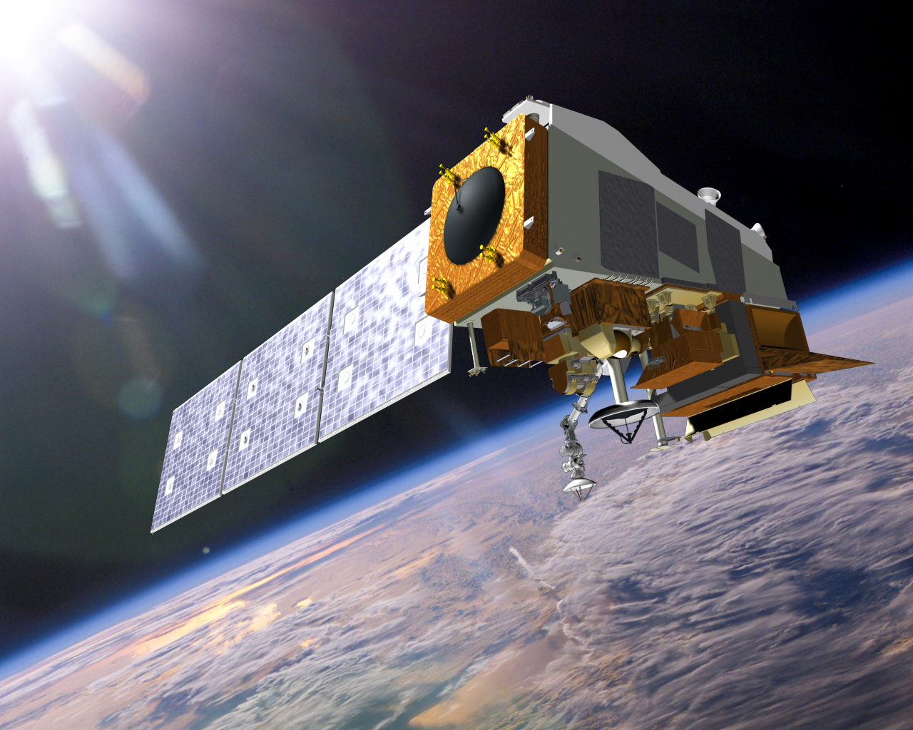
The Suomi-NPP Visible Infrared Imaging Radiometer Suite (VIIRS)
Suomi pioneered the generation of satellite products providing global measurement of nocturnal visible and near-infrared light. The high-resolution nighttime images from space, referred to by NASA as the Black Marble HD dataset, is processed to eliminate light sources like moonlight reflectance and other interferences.

Slide 13
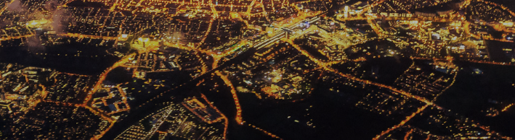
During COVID-19 lockdowns night lights in central business districts decreased

Slide 14
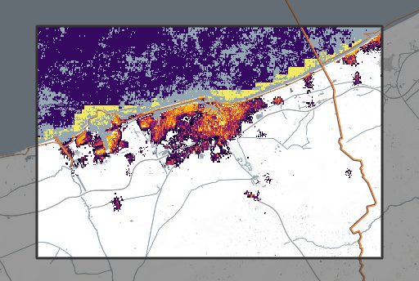
Nightlights in the Port of Dunkirk (France)

Slide 15
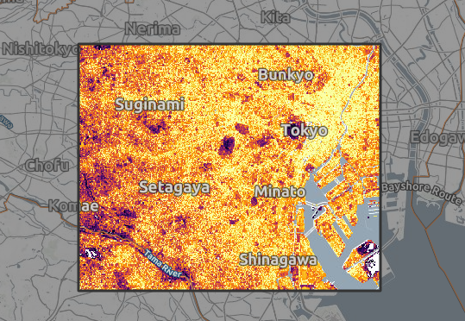
Nightlights in Tokyo, Japan

Slide 16
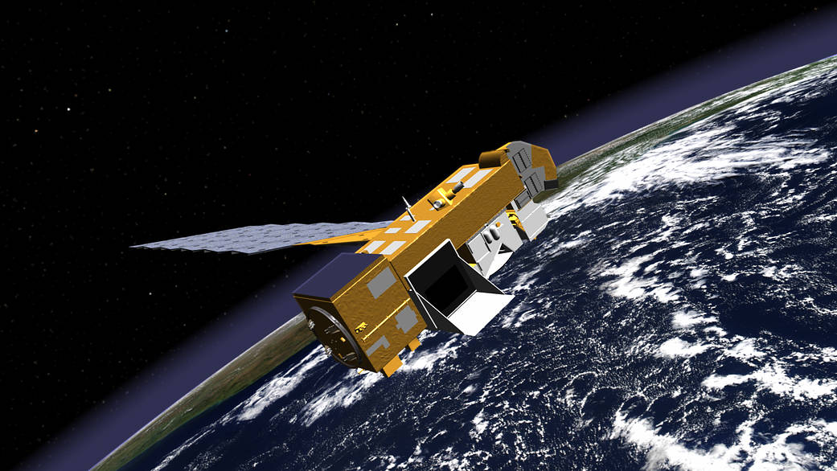
Nitrogen Dioxide (NO₂) and Sulfur Dioxide (SO₂)
A picture diary of air quality in the northeastern regions of India, China, and the United States.

Slide 17
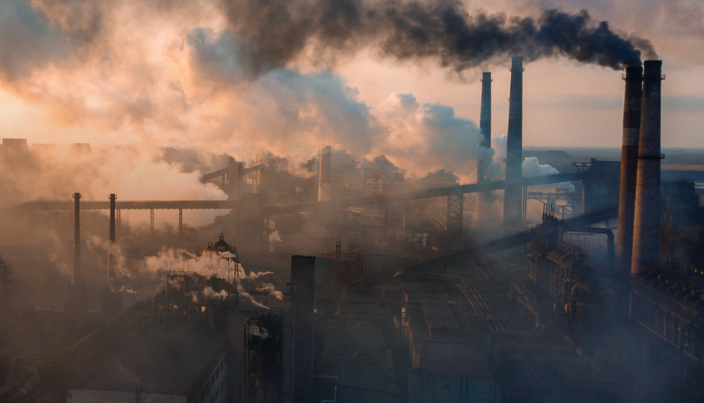
Air pollution in India, China and the U.S. have changed significantly over the past two decades

Slide 18
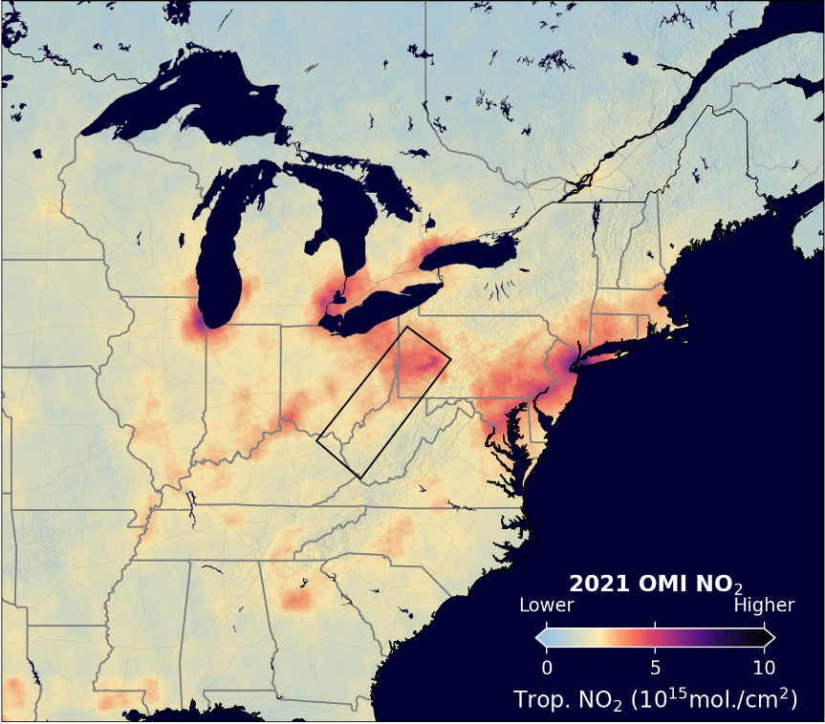

UNITED STATES For example, this image shows decreases in SO2
and NO2 in the Ohio River Valley region of the United.

Slide 19
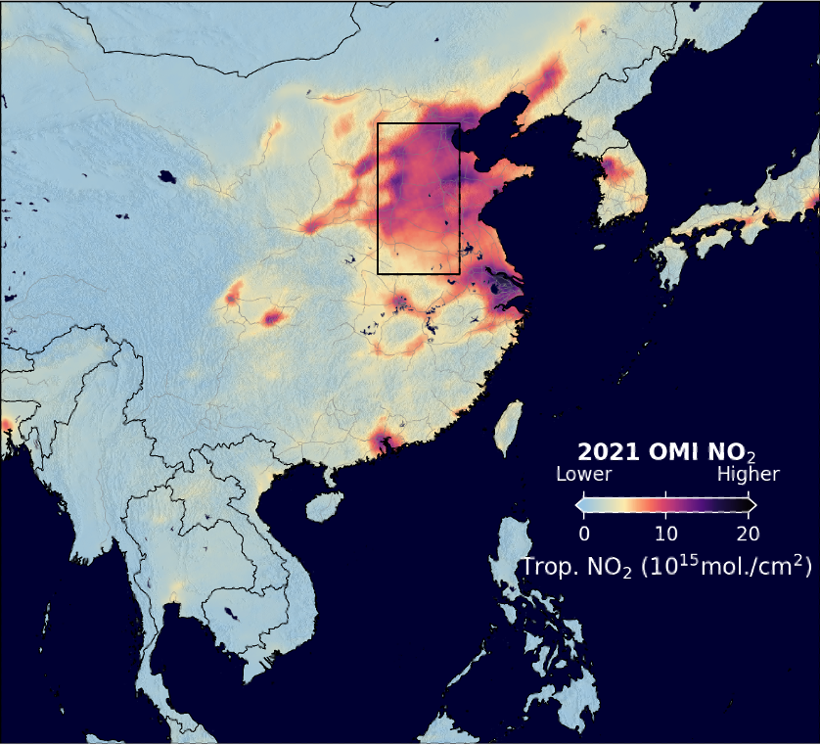

CHINA Satellite observations for northeastern China show a different story. The data for SO2 (red) show a 90% reduction in this pollutant from 2005-2021.

Slide 20
Presented by:
team nimbus

